Slide 1
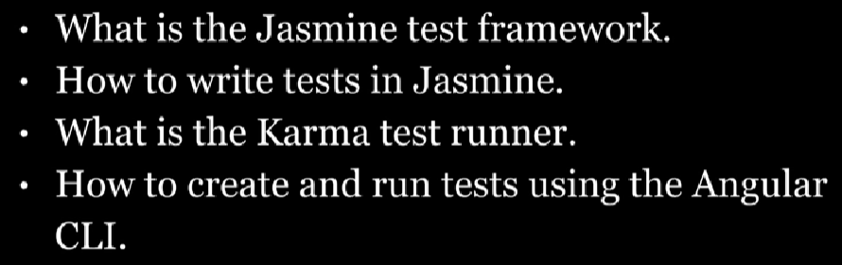
Jasmine And Karma

Slide 2
What is jasmine?
Jasmine is a JavaScript testing framework that supports a software development practice called Behaviour-Driven Development, or BDD for short. It’s a specific flavour of Test-Driven Development (TDD).
Jasmine, and BDD in general, attempts to describe tests in a human readable format so that non-technical people can understand what is being tested
Angular CLI command to test :
Ng test

Slide 3
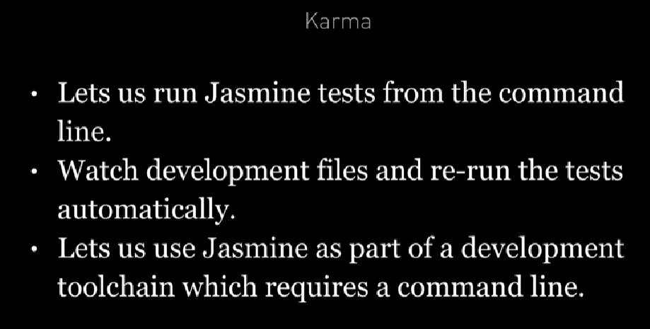

Slide 4
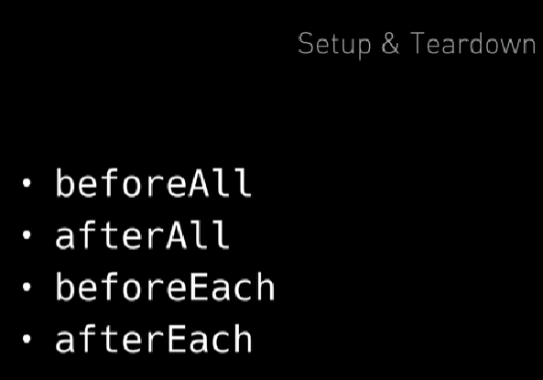
SetUp And TearDown

Slide 5
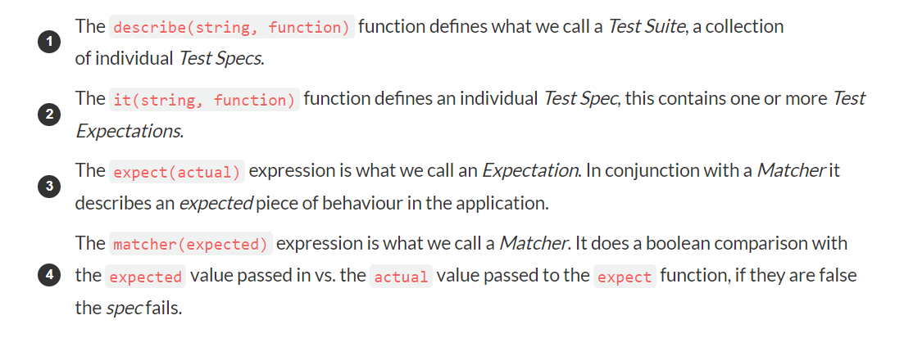
Explanation

Slide 6
Example
Jasmine, and BDD in general, attempts to describe tests in a human readable format so that non-technical people can understand what is being tested. However even if you are technical reading tests in BDD format makes it a lot easier to understand what’s going on.
function helloWorld()
{ return 'Hello world!'; }
describe('Hello world', () => {
(it('says hello', () =>
{ expect(helloWorld())
.toEqual('Hello world!'); });
});

Slide 7
Built-In Matchers
expect(array).toContain(member);
expect(fn).toThrow(string); expect(fn).toThrowError(string); expect(instance).toBe(instance); expect(mixed).toBeDefined(); expect(mixed).toBeFalsy(); expect(mixed).toBeNull(); expect(mixed).toBeTruthy(); expect(mixed).toBeUndefined(); expect(mixed).toEqual(mixed); expect(mixed).toMatch(pattern); expect(number).toBeCloseTo(number, decimalPlaces); expect(number).toBeGreaterThan(number); expect(number).toBeLessThan(number); expect(number).toBeNaN(); expect(spy).toHaveBeenCalled(); expect(spy).toHaveBeenCalledTimes(number); expect(spy).toHaveBeenCalledWith(...arguments);

Slide 8
Setup and Teardown
Sometimes in order to test a feature we need to perform some setup, perhaps it’s creating some test objects. Also we may need to perform some cleanup activities after we have finished testing, perhaps we need to delete some files from the hard drive.
These activities are called setup and teardown (for cleaning up) and Jasmine has a few functions we can use to make this easier:
beforeAll
This function is called once, before all the specs in a test suite (describe function) are run.
afterAll
This function is called once after all the specs in a test suite are finished.
beforeEach
This function is called before each test specification (it function) is run.
afterEach
This function is called after each test specification is run.

Slide 9
